Slide 1
PARALLEL DATABASES

Slide 2
Goals of Parallel Databases
Improve performance: The performance of the system can be improved by connecting multiple CPU and disks in parallel. Many small processors can also be connected in parallel.
Improve availability of data: Data can be copied to multiple locations to improve the availability of data. In the parallel database, nodes have less contact with each other, so the failure of one node doesn’t cause for failure of the entire system. This amounts to significantly higher database availability.
Improve reliability: Reliability of system is improved with completeness, accuracy and availability of data. When one site fails, the execution can continue with another available site which is having a copy of data. Making the system more reliable.
Provide distributed access of data: Companies having many branches in multiple cities can access data with the help of parallel database system.

Slide 3
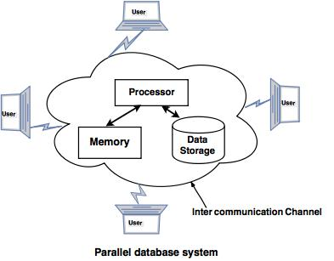

Slide 4

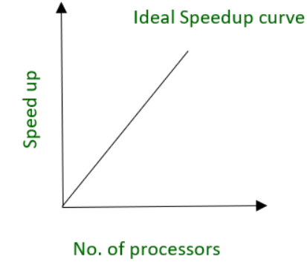
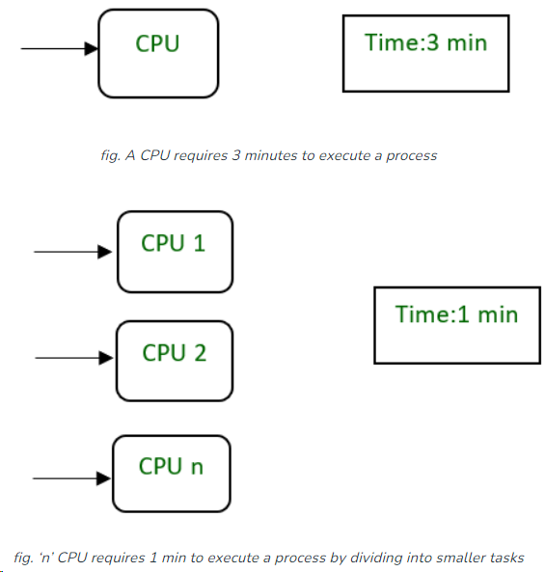
Performance Measurement of Databases : Here, we will emphasize the performance measurement factor-like Speedup and Scale-up.
Speedup – The ability to execute the tasks in less time by increasing the number of resources is called Speedup.

Slide 5
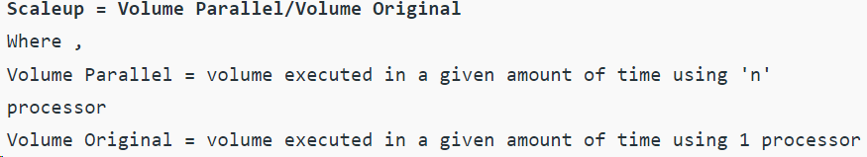
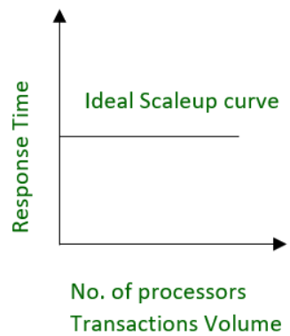
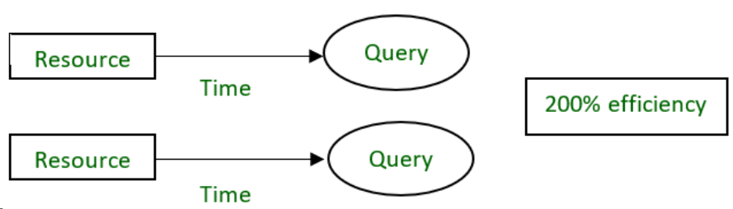
Scale-up – The ability to maintain the performance of the system when both workload and resources increase proportionally.
Example – 20 users are using a CPU at 100% efficiency. If we try to add more users, then it’s not possible for a single processor to handle additional users. A new processor can be added to serve the users parallel. And will provide 200% efficiency.

Slide 6
Types of Parallel Database Architecture
A parallel DBMS is a DBMS that runs across multiple processors or CPUs and is mainly designed to execute query operations in parallel, wherever possible.
The parallel DBMS link a number of smaller machines to achieve the same throughput as expected from a single large machine.
In Parallel Databases, mainly there are three architectural designs for parallel DBMS. They are as follows:
Shared Memory Architecture
Shared Disk Architecture
Shared Nothing Architecture

Slide 7
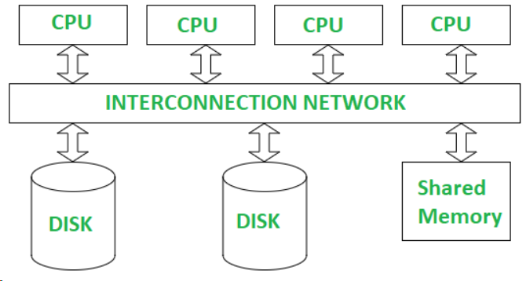
Shared Memory Architecture-
In Shared Memory Architecture, there are multiple CPUs that are attached to an interconnection network. They are able to share a single or global main memory and common disk arrays.
In this architecture, a single copy of a multi-threaded operating system and multithreaded DBMS can support these multiple CPUs.
Also, the shared memory is a solid coupled architecture in which multiple CPUs share their memory. It is also known as Symmetric multiprocessing (SMP).
Advantages :
It has high-speed data access for a limited number of processors.
The communication is efficient.
Disadvantages :
It cannot use beyond 80 or 100 CPUs in parallel.
Waiting time of processors is increased due to more number of processors.
The bus or the interconnection network gets block due to the increment of the large number of CPUs i.e. Bandwidth problem.

Slide 8
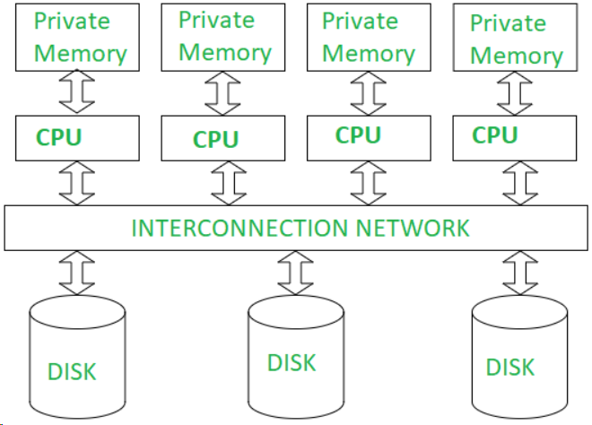
Shared Disk Architectures :
Here, various CPUs are attached to an interconnection network. In this, each CPU has its own memory and all of them have access to the same disk. Also, note that here the memory is not shared among CPUs therefore each node has its own copy of the operating system and DBMS.
Shared disk architecture is a loosely coupled architecture optimized for applications that are inherently centralized. They are also known as clusters.
Advantages :
The interconnection network is no longer a bottleneck each CPU has its own memory.
There is better fault tolerance i.e. if a processor or its memory fails, the other processor can complete the task.
Disadvantages :
It has limited scalability as large amount of data travels through the interconnection channel.
If more processors are added the existing processors are slowed down due to the problems of interference.

Slide 9
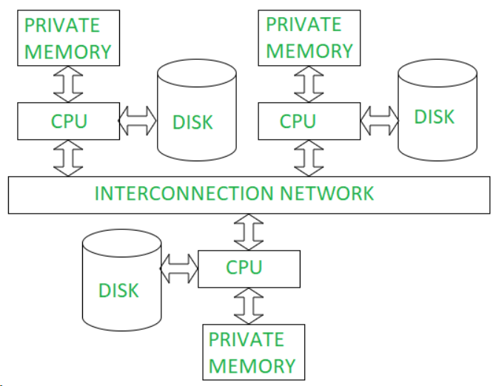
Shared Nothing Architecture :
It is multiple processor architecture in which each processor has its own memory and disk storage.
In this, multiple CPUs are attached to an interconnection network through a node. Also, note that no two CPUs can access the same disk area.
In this architecture, no sharing of memory or disk resources is done. It is also known as Massively parallel processing (MPP).
Advantages :
It has better scalability as no sharing of resources is done
Can support for many processor, which makes the system more scalable.
Disadvantages:
The cost of communications is higher as it involves sending of data and software interaction at both ends
Data partitioning is required

Slide 10
Techniques of query Evaluation
Interquery Parallelism
It is a form of parallelism where many different Queries or Transactions are executed in parallel with one another on many processors.
Advantages:-
It increases Transaction Throughput.
It scales up the Transaction processing system to support a larger number of transactions per second. Hence, best suited for On-Line Transaction Processing (OLTP) systems.
Supported Parallel Database Architectures:-
It is easy to implement in Shared Memory Parallel System. Lock tables and Log information are maintained in the same memory. Hence, it is easy to handle those transactions which shares locks with other transactions. Locking and logging can be done efficiently.
In other parallel architectures like Shared Disk and Shared Nothing, the locking and logging must be done through message passing between processors, which is considered as costly operation when compared Shared Memory Parallel architecture.
Oracle 8 and Oracle Rdb are the examples of Database systems which support Inter-query Parallelism.

Slide 11
For example: If there are 6 queries, each query will take 3 seconds for evaluation. Thus, the total time taken to complete evaluation process is 18 seconds. Inter query parallelism achieves this task only in 3 seconds.
However, Inter query parallelism is difficult to achieve every time.

Slide 12
Intraquery Parallelism
It is the form of parallelism where Single Query is executed in parallel on many processors.
In this technique query is divided in sub queries which can run simultaneously on different processors, this will minimize the query evaluation time.
Intra query parallelism improves the response time of the system.
Advantages:-
To speed up a single complex long running queries.
Best suited for complex scientific calculations (queries).
Supported Parallel Database Architectures:-
Shared Memory, Shared Disk and Shared Nothing parallel architectures are supported. We need not worry about locking and logging as because it involves parallelizing single query.

Slide 13
It is about executing a single query in parallel using multiple processors or disks. This can be done by dividing the data into many smaller units and execute the query on those smaller tables. We have so many queries which are complex and consume more time and resources.
For example, consider the query given below;
SELECT * FROM Email ORDER BY Start_Date;
If 10000 records are distributed equally into 10 processors, 1000 each, then every processor can sort 1000 records in lesser time, later it can be combined/merged using other algorithms to produce final sorted result.

Slide 14
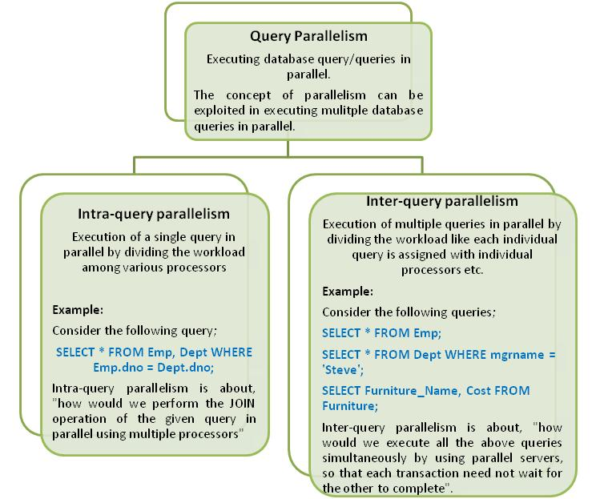

Slide 15
Types of IntraQuery Parallelism
Intra-operation parallelism – the process of speeding up a query through parallelizing the execution of individual operations. The operations which can be parallelized are Sort, Join, Projection, Selection and so on.
Inter-operation parallelism – the process of speeding up a query through parallelizing various operations which are part of the query. For example, a query which involves join of 4 tables can be executed in parallel in two processors in such a way that each processor shall join two relations locally and the result1 and result2 can be joined further to produce the final result.
Informix, Terradata are examples of Database systems which support Intra-query Parallelism

Slide 16
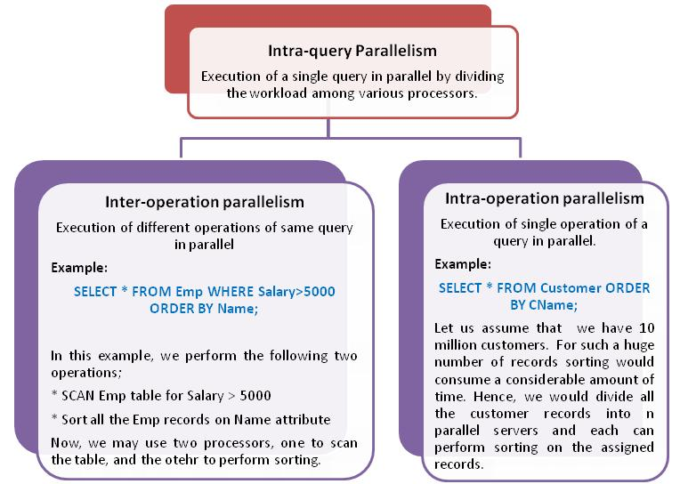

Slide 17
Inter-operation Parallelism
It is about executing different operations of a query in parallel. A single query may involve multiple operations at once. We may exploit parallelism to achieve better performance of such queries.
Consider the example query given below;
SELECT * FROM Student, CourseRegd
WHERE Student.Regno = CourseRegd.Regno;
For example, if Student has 10000 records and CourseRegd has 60000 records, then join requires 10000 X 60000 comparisons. If we exploit parallelism in here, we could achieve better performance.
The following are the variants using which we would achieve Interoperation Parallelism:
1. Pipelined Parallelism
2. Independent Parallelism

Slide 18
Pipelined Parallelism
In Pipelined Parallelism, the idea is to consume the result produced by one operation by the next operation in the pipeline. For example, consider the following operation;
r1 ⋈r2 ⋈ r3 ⋈ r4
Advantage:-
We do not need to store the intermediate results, and instead the result produced at one processor can be consumed directly by the other.
Disadvantage:-
1. Pipelined parallelism is not the good choice, if degree of parallelism is high.
2. Useful with small number of processors.
3. Not all operations can be pipelined.

Slide 19
Independent Parallelism
Operations that are not depending on each other can be executed in parallel at different processors. This is called as Independent Parallelism.
For example, in the expression r1 ⋈ r2 ⋈ r3 ⋈ r4, the portion r1 ⋈ r2 can be done in one processor, and r3 ⋈ r4 can be performed in the other processor. Both results can be pipelined into the third processor to get the final result.
Disadvantages:
Does not work well in case of high degree of parallelism.

Slide 20
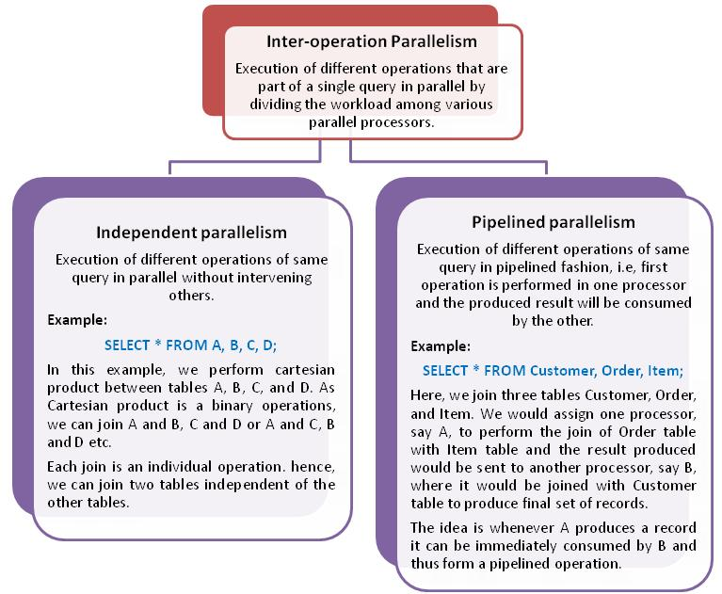

Slide 21
Intra-operation Parallelism
It is about parallelizing a single relational operation given in a query.
Consider the example query given below;
SELECT AVG(Salary) FROM Employee GROUP BY Dept_Id;

Slide 22
There are many such relational operations which can be executed in parallel using many processors on subsets of the table/tables mentioned in the query.
The following list includes the relational operations and various techniques used to implement those operations in parallel.
Parallel Sort
Range Partitioning Sort
Parallel External Sort-Merge
Parallel Join
Partitioned Join
Fragment and Replicate Join
Partitioned Parallel Hash Join
Selection
Duplicate Elimination
Projection
Aggregation

Slide 23
Parallel Sort - Range Partitioning Sort
Assumptions:
Assume n processors, P0, P1, …, Pn-1 and n disks D0, D1, …, Dn-1.
Disk Di is associated with Processor Pi.
Relation R is partitioned into R0, R1, …, Rn-1 using Round-robin technique or Hash Partitioning technique or Range Partitioning technique (if range partitioned on some other attribute other than sorting attribute)
Steps:
Step 1: Partition the relations Ri on the sorting attribute A at every processor using a range vector v. Send the partitioned records which fall in the ith range to Processor Pi where they are temporarily stored in Di.
Step 2: Sort each partition locally at each processor Pi. And, send the sorted results for merging with all the other sorted results which is trivial process.

Slide 24
Parallel Sort - Range Partitioning Sort
Example:
Consider the following relation schema Employee:-
Employee (Emp_ID, EName, Salary)
Assume that relation Employee is partitioned using Round-robin technique into 3 disks D0, D1, and D2 which are associated with processors P0, P1, and P2.
At processors P0, P1, and P2, the relations are named Employee0, Employee1 and Employee2 respectively.

Slide 25
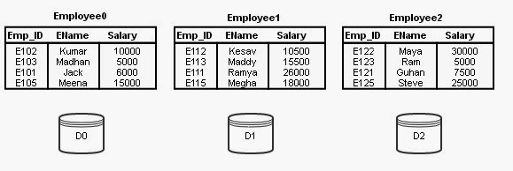
Assume that the following sorting query is initiated.
SELECT * FROM Employee ORDER BY Salary;

Slide 26
Parallel Sort - Range Partitioning Sort
The Range-Partitioning technique works as follows;
Step 1:
At first we have to identify a range vector v on the Salary attribute. The range vector is of the form v[v0, v1, …, vn-2]. For our example, let us assume the following range vector;
v[14000, 24000]
This range vector represents 3 ranges, range 0 (14000 and less), range 1 (14001 to 24000) and range 2 (24001 and more).
Redistribute the relations Employee0, Employee1 and Employee2 using these range vectors into 3 disks temporarily. After this distribution disk 0 will have range 0 records (i.e, records with salary value less than or equal to 14000), disk 1 will have range 1 records (i.e, records with salary value greater than 14000 and less than or equal to 24000), and disk 2 will have range 2 records (i.e, records with salary value greater than 24000).
This redistribution according to range vector v is represented in Figure 2 as links to all the disks from all the relations. Temp_Employee0, Temp_Employee1, and Temp_Employee2, are the relations after successful redistribution. These tables are stored temporarily in disks D0, D1, and D2. (They can also be stored in Main memories (M0, M1, M2) if they fit into RAM).

Slide 27
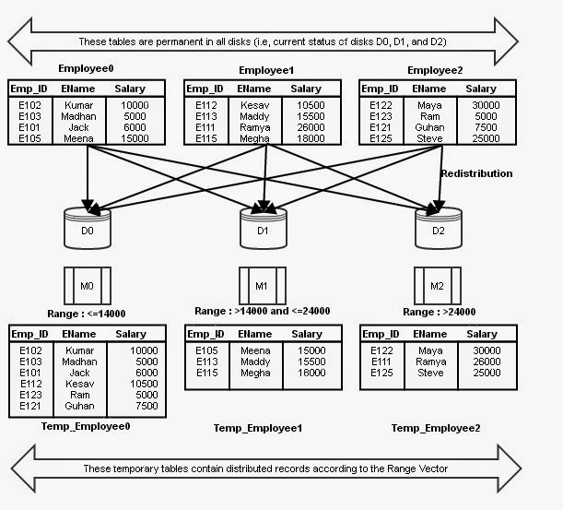

Slide 28
Step 2:
Now, we got temporary relations at all the disks after redistribution.
At this point, all the processors sort the data assigned to them in ascending order of Salary individually. The process of performing the same operation in parallel on different sets of data is called Data Parallelism.
Final Result:
After the processors completed the sorting, we can simply collect the data from different processors and merge them. This merge process is straightforward as we have data already sorted for every range. Hence, collecting sorted records from partition 0, partition 1 and partition 2 and merging them will give us final sorted output.

Slide 29
Parallel Sort - Parallel External Sort-Merge
Steps:
Step 1: Sort the relation partition Ri which is stored on disk Di on the sorting attribute of the query.
Step 2: Identify a range partition vector v and range partition every Ri into processors, P0, P1, …, Pn-1 using vector v.
Step 3: Each processor Pi performs a merge on the incoming range partitioned data from every other processors (The data are actually transferred in order. That is, all processors send first partition into P0, then all processors sends second partition into P1, and so on).
Step 4: Finally, concatenate all the sorted data from different processors to get the final result.

Slide 30

Parallel Sort - Parallel External Sort-Merge
Example:
Consider the following relation schema Employee:- Employee (Emp_ID, EName, Salary)
Assume that relation Employee is permanently partitioned using Round-robin technique into 3 disks D0, D1, and D2 which are associated with processors P0, P1, and P2. At processors P0, P1, and P2, the relations are named Employee0, Employee1 and Employee2 respectively.
Partitioned Employee

Slide 31
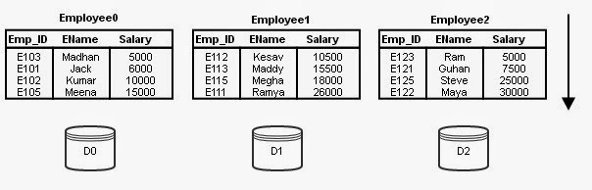
Parallel Sort - Parallel External Sort-Merge
Assume that the following sorting query is initiated.
SELECT * FROM Employee ORDER BY Salary;
As already said, the table Employee is not partitioned on the sorting attribute Salary. Then, the Parallel External Sort-Merge technique works as follows;
Step 1:
Sort the data stored in every partition (every disk) using the ordering attribute Salary. (Sorting of data in every partition is done temporarily). At this stage every Employee contains salary values of range minimum to maximum. The partitions sorted in ascending order is shown below
Partitioned Employee in ascending order on Salary attribute

Slide 32
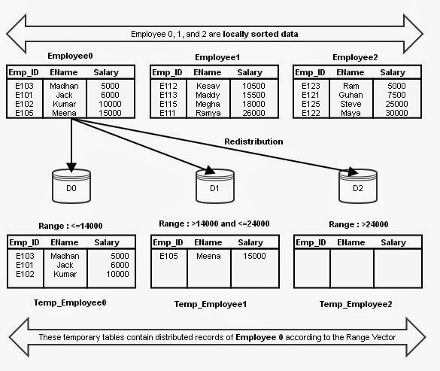
Step 2:
We have to identify a range vector v on the Salary attribute. The range vector is of the form v[v0, v1, …, vn-2]. For our example, let us assume the following range vector;
v[14000, 24000]
This range vector represents 3 ranges, range 0 (14000 and less), range 1 (14001 to 24000) and range 2 (24001 and more).
Redistribute every partition (Employee0, Employee1 and Employee2) using these range vectors into 3 disks temporarily. What would be the status of Temp_Employee 0, 1, and 2 after distributing Employee 0 is given in Figure.
Distribution of Employee 0 according to the range vector

Slide 33
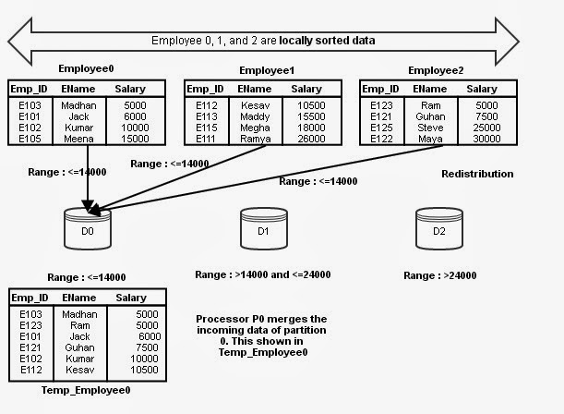
Step 3:
Actually, the above said distribution is executed at all processors in parallel such that processors P0, P1, and P2 are sending the first partition of Employee 0, 1, and 2 to disk 0. Upon receiving the records from various partitions, the receiving processor P0 merges the sorted data.
Merging data of range <=14000 at D0 from all the disks

Slide 34
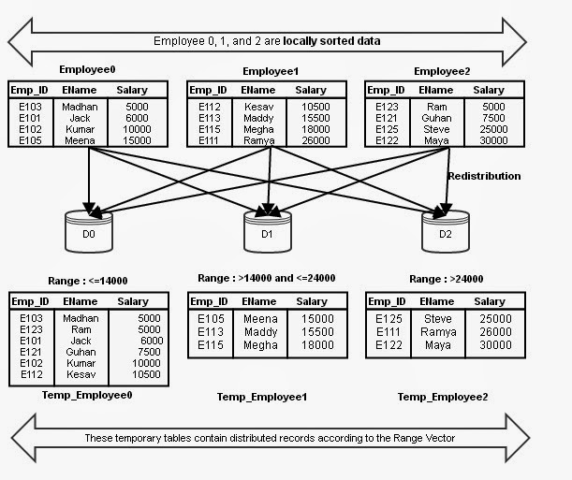
The above said process is done at all processors for different partitions.
The final version of Temp_Employee 0, 1, and 2
Step 4: Finally, concatenate all the sorted data from different processors to get the final result.

Slide 35
Parallel Join Technique - Partitioned Join
The relational tables that are to be joined gets partitioned on the joining attributes of both tables using same partitioning function to perform Join operation in parallel.
How does Partitioned Join work?
Assume that relational tables r and s need to be joined using attributes r.A and s.B. The system partitions both r and s using same partitioning technique into n partitions. In this process A and B attributes (joining attributes) to be used as partitioning attributes as well for r and s respectively. r is partitioned into r0, r1, r2, …, rn-1 and s is partitioned into s0, s1, s2, …, sn-1. Then, the system sends partitions ri and si into processor Pi, where the join is performed locally.

Slide 36
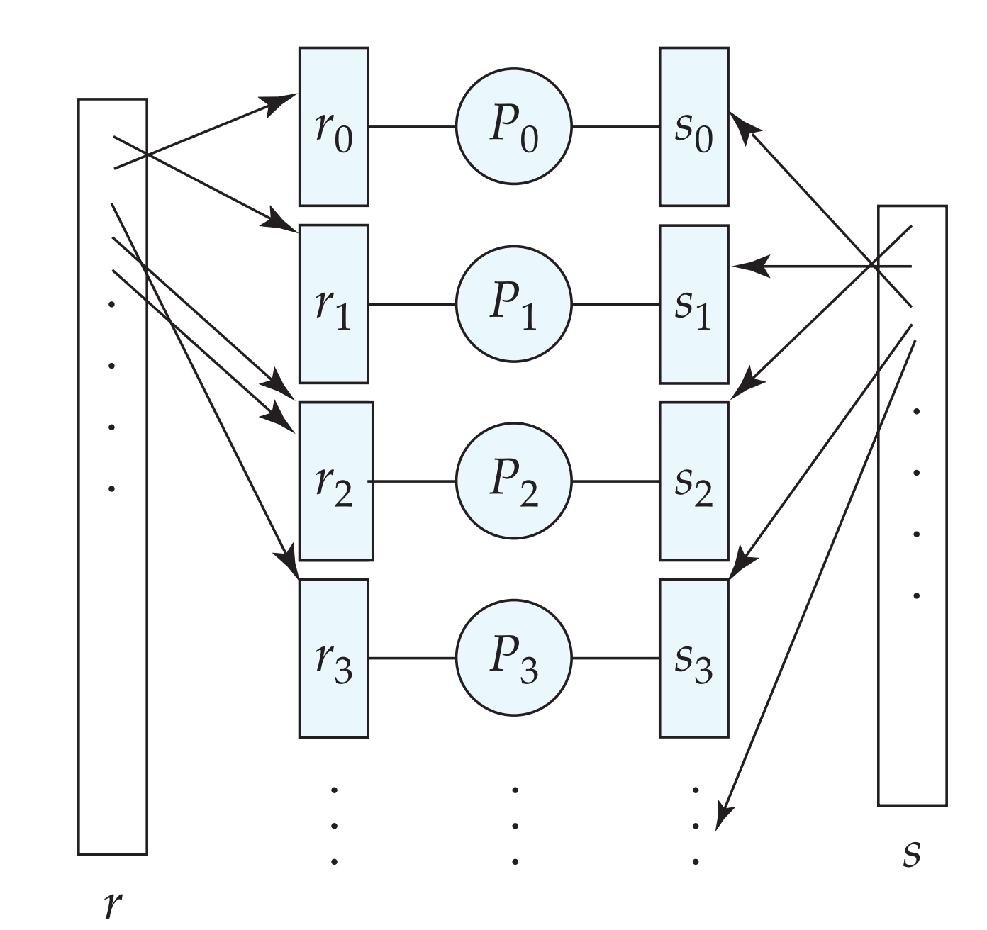
Parallel Join Technique - Partitioned Join

Slide 37
Parallel Join Technique - Partitioned Join
What type of joins can we perform in parallel using Partitioned Join?
Only joins such as Equi-Joins and Natural Joins can be performed using Partitioned join technique.
Why Equi-Jion and Natural Jion?
Equi-Join or Natural Join is done between two tables using an equality condition such as r.A = s.B. The tuples which are satisfying this condition, i.e, same value for both A and B, are joined together. Others are discarded. Hence, if we partition the relations r and s on applying certain partitioning technique on both A and B, then the tuples having same value for A and B will end up in the same partition.

Slide 38
Parallel Join Technique - Partitioned Join
RegNo | SName | Gen | Phone
1 | Sundar | M | 9898786756
3 | Karthik | M | 8798987867
4 | John | M | 7898886756
2 | Ram | M | 9897786776
RegNo | Courses
4 | Database
2 | Database
3 | Data Structures
1 | Multimedia
Table 1 - STUDENT
Table 2 – COURSES_REGD

Slide 39
Parallel Join Technique - Partitioned Join
Let us assume the following;
The RegNo attributes of tables STUDENT and COURSES_REGD are used for joining.
Observe the order of tuples in both tables. They are not in particular order. They are stored in random order on RegNo.
Partition the tables on RegNo attribute using Hash Partition. We have 2 disks and we need to partition the relational tables into two partitions (possibly equal). Hence, n is 2.
The hash function is, h(RegNo) = (RegNo mod n) = (RegNo mod 2). And, if we apply the hash function we shall get the tables STUDENT and COURSES_REGD partitioned into Disk0 and Disk1 as stated below.

Slide 40
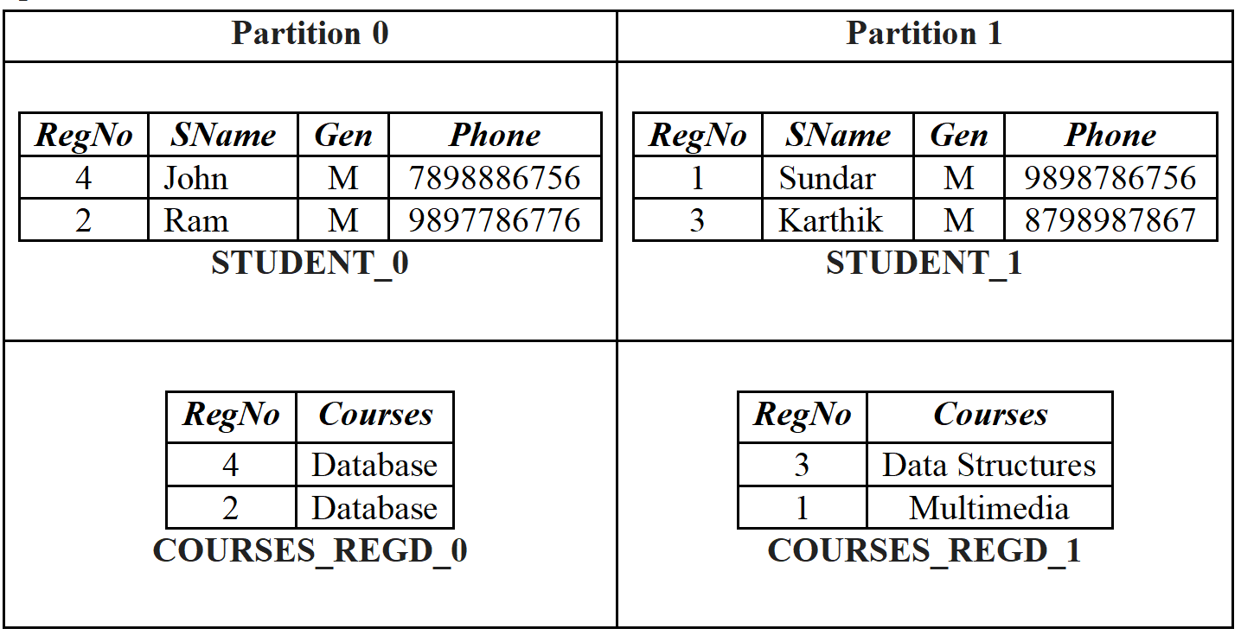
From the above table, it is very clear that the same RegNo values of both tables STUDENT and COURSES_REGD are sent to same partitions. Now, join can be performed locally at every processor in parallel.
One more interesting fact about this join is, only 4 (2 Student records X 2 Courses_regd records) comparisons need to be done in every partition for our example. Hence, we need total of 8 comparisons in partitioned join against 16 (4 X 4) in conventional join.

Slide 41
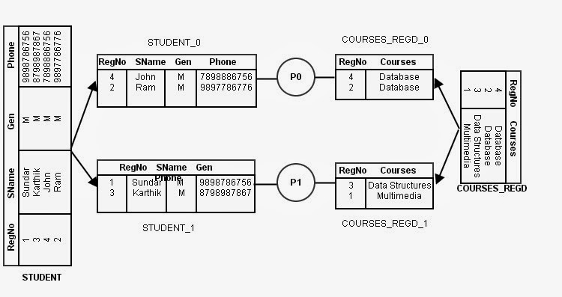

Slide 42
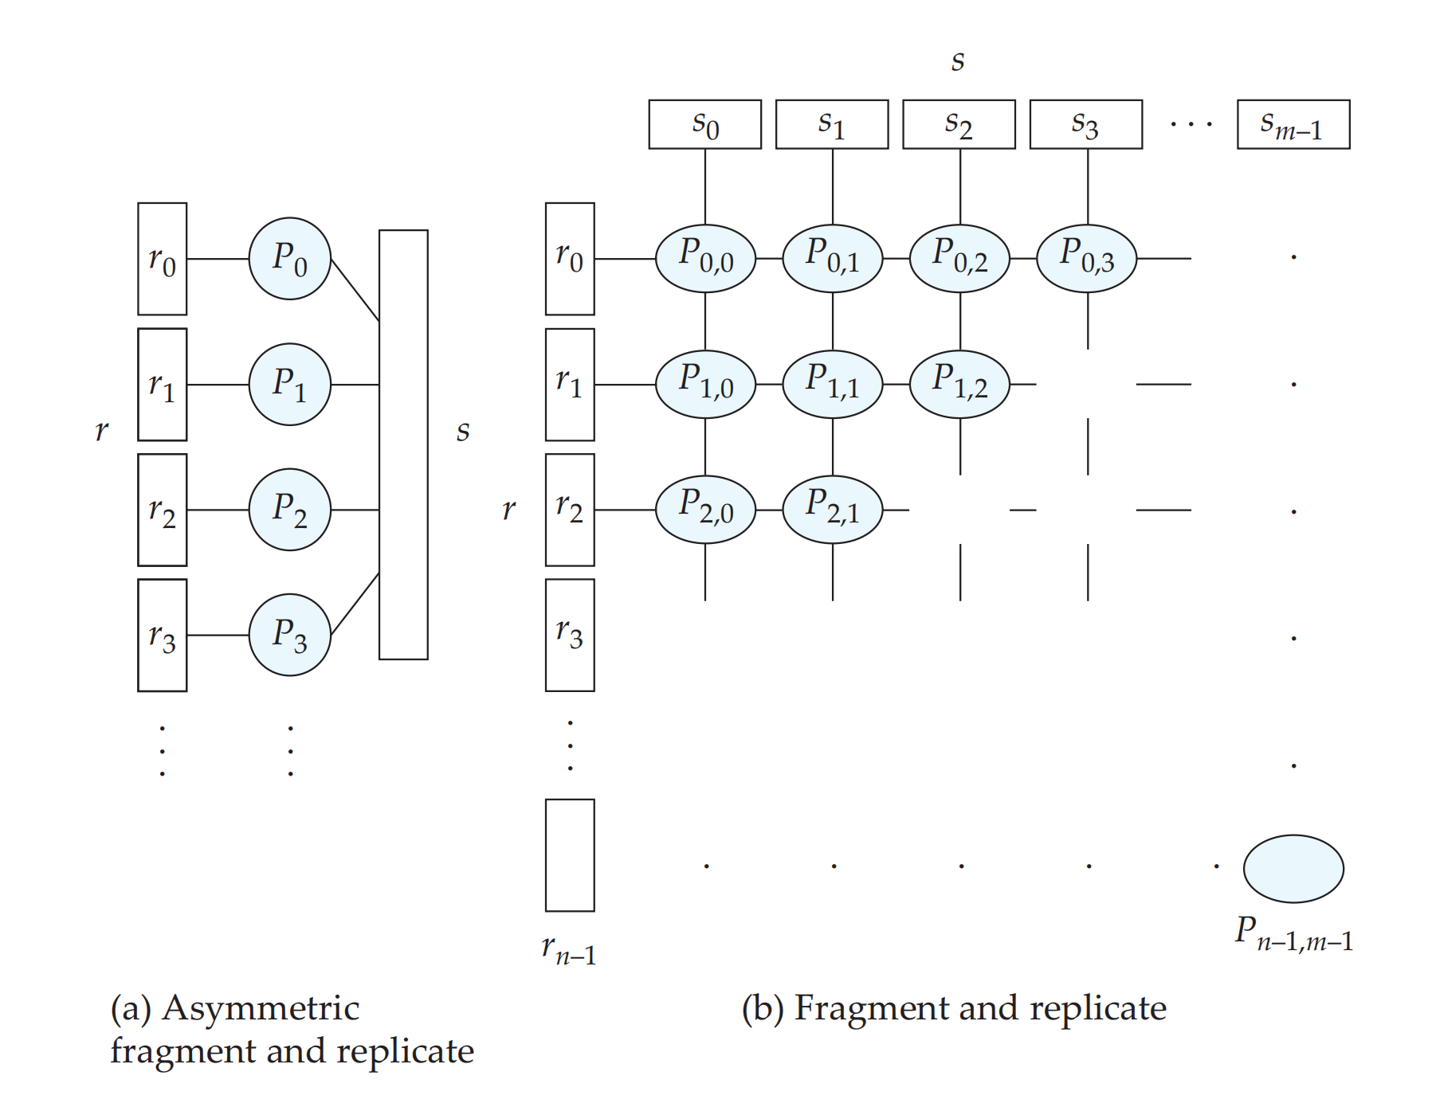
Parallel Join Technique - Fragment and Replicate Join
Fragment means partitioning a table either horizontally or vertically (Horizontal and Vertical fragmentation).
Replicate means duplicating the relation, i.e, generating similar copies of a table. This join is performed by fragmenting and replicating the tables to be joined.

Slide 43
Parallel Join Technique - Fragment and Replicate Join
(a) Asymmetric Fragment and Replicate Join
It is a variant of Fragment and Replicate join. It works as follows;
1. The system fragments table r into n fragments such that r₀, r₁, r₂, .., r_{n-1}, where r is one of the tables that is to be joined and n represents the number of processors. Any partitioning technique, round-robin, hash or range partitioning could be used to partition the relation.
2. The system replicates the other table, say s into n processors. That is, the system generates n copies of s and sends to n processors.
3. Now we have, r₀ and s in processor P₀, r₁ and s in processor P₁, r₂ and s in processor P₂, .., r_{n-1} and s in processor P_{n-1}. The processor Pi is performing the join locally on r_{i} and s.

Slide 44
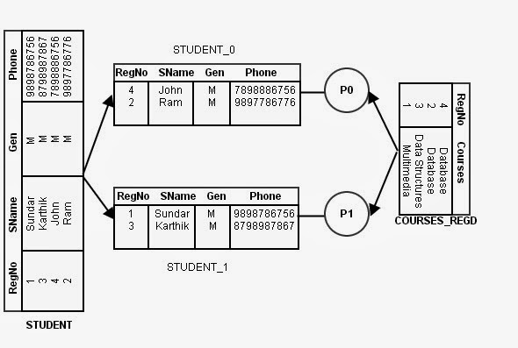
Parallel Join Technique - Fragment and Replicate Join

Slide 45
Parallel Join Technique - Fragment and Replicate Join
(a) Asymmetric Fragment and Replicate Join
Non-equi join can be performed in parallel.
If one of the relations to be joined is already partitioned into n processors, this technique is best suited, because we need to replicate the other relation.
Unlike in Partitioned Join, any partitioning techniques can be used.
If one of the relations to be joined is very small, the technique performs better.

Slide 46
Parallel Join Technique - Fragment and Replicate Join
(b) Fragment and Replicate Join
It is the general case of Asymmetric Fragment-and-Replicate join technique. Asymmetric technique is best suited if one of the relations to be joined is small, and if it can fit into memory. If the relations that are to be joined are large, and the joins is non-equal then we need to use Fragment-and-Replicate Join. It works as follows;
1. The system fragments table r into m fragments such that r₀, r₁, r₂, .., r_{m-1}, and s into n fragments such that s₀, s₁, s₂, .., s_{n-1 .} Any partitioning technique, round-robin, hash or range partitioning could be used to partition the relations.
2. The values for m and n are chosen based on the availability of processor. That is, we need at least m*n processors to perform join.

Slide 47
Parallel Join Technique - Fragment and Replicate Join
(b) Fragment and Replicate Join
3. Now we have to distribute all the partitions of r and s into available processors. And, remember that we need to compare every tuple of one relation with every tuple of other relation. That is the records of r₀ partition should be compared with all partitions of s, and the records of partition s₀ should be compared with all partitions of r. This must be done with all the partitions of r and s as mentioned above. Hence, the data distribution is done as follows;
a. As we need m*n processors, let us assume that we have processors P_{0,0}, P_{0,1}, …, P_{0,n-1}, P_{1,0}, P_{1,1}, …, P_{m-1,n-1}. Thus, processor P_{i,j} performs the join of r_{i} with s_{j}.
b. To ensure the comparison of every partition of r with every other partition of s, we replicate r_{i} with the processors, P_{i,0}, P_{i,1}, P_{i,2}, …, P_{i,n-1}, where 0, 1, 2, …, n-1 are partitions of s. This replication ensures the comparison of every r_{i} with complete s.
c. To ensure the comparison of every partition of s with every other partition of r, we replicate s_{i} with the processors, P_{0,i}, P_{1,i}, P_{2,i}, …, P_{m-1,i}, where 0, 1, 2, …, m-1 are partitions of r. This replication ensures the comparison of every s_{i} with complete r.
4. P_{i,j} computes the join locally to produce the join result.

Slide 48
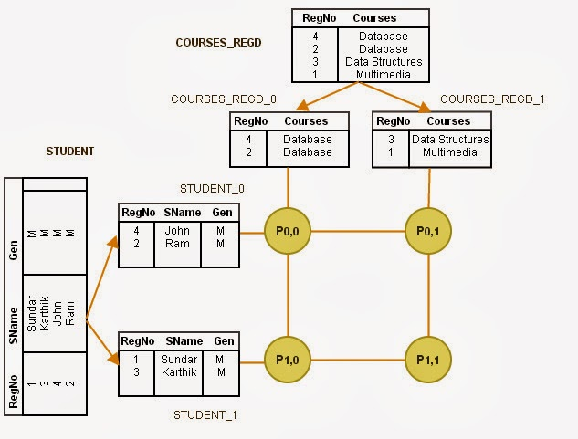
Parallel Join Technique - Fragment and Replicate Join

Slide 49
Parallel Join Technique - Fragment and Replicate Join
1. Asymmetric Fragment-and-replicate join is the special case of general case Fragment-and-replicate join, where n or m is 1, i.e, if one of the relation does not have partitions.
2. When compared to asymmetric technique, Fragment-and-replicate join reduces the size of the tables at every processor.
3. Any partitioning techniques can be used and any joining technique can be used as well.
4. Fragment-and-replicate technique suits both Equi-join and Non-equi join.
5. It involves higher cost in partitioning.

Slide 50
Parallel Join Technique - Partitioned Parallel Hash Join
Assume that we have,
n processors, P0, P1, …, Pn-1
two tables, r and s (r and s are already partitioned into disks of n processors),
s is the smaller table
Parallel Hash-Join Algorithm:
Step 1: Choose a hash function h1. h1 should be able to take the join attribute value of each tuple of relations r and s, and maps them to one of the n processors.
Step 2: Smaller relations s is taken as the Build relation.

Slide 51
Step 3: Each processor Pi reads the tuples of smaller relation s in it’s disk Di, and sends them to different processors based on the hash function h1.
Step 4: On receiving the records of si at every destination processor Pi, the Pi further partitions the tuples using another hash function h2. This hash function is used for joining the tuples locally at every processor. This step is independent for any processor.
Step 5: On completion of the distribution of all the records of smaller relation s, it is now the turn for the larger relation r. Step 3 is done for all the records of relation r.
Step 6: On receiving the records of ri at every destination processor Pi, the Pi further partitions the tuples using another hash function h2. This phase is called the Probe Phase.
Step 7: At last, all the records which can be joined will be in same processors’ same partitions. Each processor Pi executes the build and probe phases of the hash–join algorithm on the local partitions ri and si of r and s to produce a partition of the final result of the hash–join.
Hash Join at each processor is independent of the other.
It works for equi-join and natural join conditions

Slide 52
SELECTION operation
SELECT list_of_attributes FROM table_name WHERE condition;
This query can be parallelized based on the condition given in the WHERE clause.
CASE 1: If the condition is of the form “a = value”, then;
If the given table is partitioned on a, then we need to execute the selection operation in only single processor where in the given attribute is partitioned.
CASE 2: If the condition is of the form “value1 <= a <= value2” (i.e, a falls in a range), then;
If the given relation is range partitioned on a, then we need to perform selection at all the processors wherever the range overlaps with the given range value1 to value2.
CASE 3: In all the other cases, the selection performed in parallel in all the processors. That is, for all the other type of queries, the selection can be done in parallel in all the processors, because, the data are partitioned over several processors.

Slide 53
Duplicate elimination
Duplicate elimination is about removing duplicate values or neglecting repeated values that are stored in an attribute for various reasons.
For example, in one or all of the following situations we need duplicate elimination:
When we would like to count the number of unique values present in a table under a particular attribute.
When we need to retrieve the values and present only the unique values of an attribute.
When we need to join two tables, etc.
The main approach used for duplicate elimination is by sorting the data on the attribute where in the duplicate values to be removed.

Slide 54
Duplicate elimination can be achieved in the following two ways in parallel database
1. During parallel sort, if we find any repeated values while partitioning, those can be discarded immediately.
In a table while you partition the data, you send tuples to different partitions based on the partition attribute and conditions. Suppose that we are partitioning on Salary attribute. During the process, if you find any of the repeated values which are already send into a partition, you can discard those values if they repeat.
2. We can partition the table into many partitions(using range or hash partitioning) , and instruct all the processors to sort the data locally and remove the duplicates(This works only for the data that are hash or range partitioned on the duplicate elimination attribute).

Slide 55
Projection
Projection means selection of one or more attributes from a table with the records stored in them.
This operation can be parallelized as follows;
1. Projection without duplicate elimination: while you read data into various disks during partitioning, you can project the required columns.
2. Projection with duplicate elimination: any of the techniques suggested in Duplicate elimination section above can be used.

Slide 56
Aggregation
Aggregation operation involves finding the count of records, sum of values stored in an attribute, minimum or maximum value of all the values stored in an attribute, and average value of all the attribute values. This operation basically needs grouping.
For example, we can find the sum of salary for all the records of Employee table, or we can find sum of salary with some filter conditions. In the first case, all the records of Employee table come under one group. In the later case, we choose the group based on the conditions included.

Slide 57
Issues of Parallel Systems
Since large-scale parallel database systems are used primarily for storing large volumes of data, and for processing decision-support queries on those data, these topics are the most important in a parallel database system.
Parallel loading of data from external sources is an important requirement, if we are to handle large volumes of incoming data.
A large parallel database system must also address these availability issues:
1. Resilience to failure of some processors or disks.
2. Online reorganization of data and schema changes.

Slide 58
1.Resilience to failure of some processors or disks.
With a large number of processors and disks, the probability that at least one processor or disk will malfunction is significantly greater than in a single processor system with one disk. A poorly designed parallel system will stop functioning if any component (processor or disk) fails.
Assuming that the probability of failure of a single processor or disk is small, the probability of failure of the system goes up linearly with the number of processors and disks.
If a single processor or disk would fail once every 5 years, a system with 100 processors would have a failure every 18 days.
Therefore, large-scale parallel database systems, such as Teradata, and IBM Informix XPS, are designed to operate even if a processor or disk fails. Data are replicated across at least two processors. If a processor fails, the data that it stored can still be accessed from the other processors.
The system keeps track of failed processors and distributes the work among functioning processors. Requests for data stored at the failed site are automatically routed to the backup sites that store a replica of the data.

Slide 59
2. Online reorganization of data and schema changes.
When we are dealing with large volumes of data (ranging in the terabytes), simple operations, such as creating indices, and changes to schema, such as adding a column to a relation, can take a long time—perhaps hours or even days.
Therefore, it is unacceptable for the database system to be unavailable while such operations are in progress. Most database systems allow such operations to be performed online, that is, while the system is executing other transactions.
Example:- online index construction.
A system that supports this feature allows insertions, deletions, and updates on a relation even as an index is being built on the relation. The index-building operation therefore cannot lock the entire relation in shared mode, as it would have done otherwise.
Instead, the process keeps track of updates that occur while it is active and incorporates the changes into the index being constructed.

